Slide 1
GENERICS IN C#

Slide 2
contents
Introduction to generics
Benefits of generics
Generic Class
Generic Interface
Generic Method
Generic Delegate

Slide 3
Introduction to Generics
Generics introduced in C# 2.0. Generics allow you to define a class with placeholders for the type of its fields, methods, parameters, etc. Generics replace these placeholders with some specific type at compile time.
A generic class can be defined using angular brackets <>. For example, the following is a simple generic class with a generic member variable, generic method and property.

Slide 4
Benefits
Increases the reusability of the code.
Generic are type safe. You get compile time errors if you try to use a different type of data than the one specified in the definition.
Generic has a performance advantage because it removes the possibilities of boxing and unboxing.
LinkedList<string> llist = new LinkedList<string>();

Slide 5
Generic Class
class MyGenericClass<T>
{
private T genericMemberVariable;
public MyGenericClass(T value)
{
genericMemberVariable = value;
}
public T genericMethod(T genericParameter)
{
Console.WriteLine("Parameter type: {0}, value: {1}", typeof(T).ToString(),genericParameter);
Console.WriteLine("Return type: {0}, value: {1}", typeof(T).ToString(), genericMemberVariable);
Return genericMemberVariable;
}
public T genericProperty
{
get; set;
}
}

Slide 6
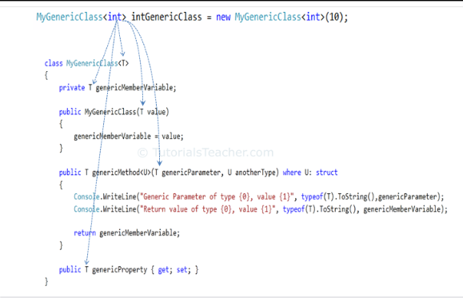

Slide 7
Generic Interfaces
The preference for generic classes is to use generic interfaces, such as IComparable<T> rather than IComparable, in order to avoid boxing and unboxing operations on value types.
class Stack<T> where T : System.IComparable<T>, IEnumerable<T> { }
interface IDictionary<K, V> { }
interface IMonth<T> { }
interface IJanuary : IMonth<int> { } //No error
interface IFebruary<T> : IMonth<int> { } //No error
interface IMarch<T> : IMonth<T> { } //No error
//interface IApril<T> : IMonth<T, U> {} //Error

Slide 8
Generic Delegates
The delegate defines the signature of the method which it can invoke. A generic delegate can be defined the same way as delegate but with generic type.
A generic delegate can point to methods with different parameter types. However, the number of parameters should be the same.

Slide 9
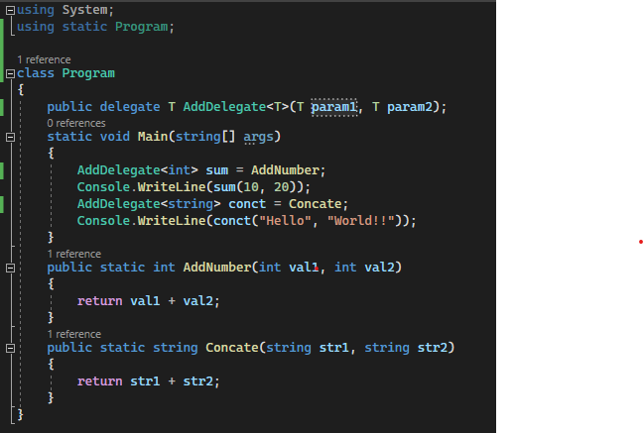

Slide 10
Points to Remember
Generics denotes with angular bracket <>.
Compiler applies specified type for generics at compile time.
Generics can be applied to interface, abstract class, method, static method, property, event, delegate and operator.
Generics performs faster by not doing boxing & unboxing.

Slide 11
Anonymous methods
In C#

Slide 12
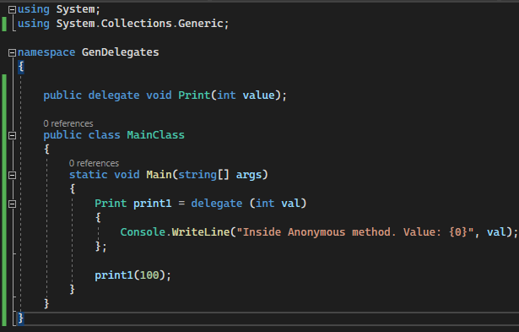
An anonymous method is a method without a name.
Anonymous methods in C# can be defined using the delegate keyword and can be assigned to a variable of delegate type.
Example:

Slide 13
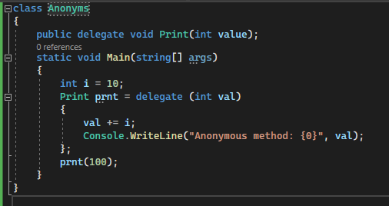
Anonymous methods can access variables defined in an outer function.

Slide 14
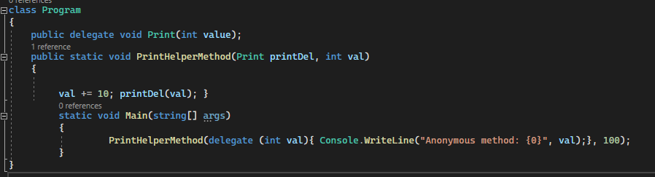
Anonymous methods can also be passed to a method that accepts the delegate as a parameter.

Slide 15
Anonymous methods can be used as event handlers:
saveButton.Click += delegate(Object o, EventArgs e)
{
System.Windows.Forms.MessageBox.Show("Save Successfully!");
};
Typical usage of an anonymous method is to assign it to an event.

Slide 16
Limitations
It cannot contain jump statement like goto, break or continue.
It cannot access ref or out parameter of an outer method.
It cannot have or access unsafe code.
It cannot be used on the left side of the is operator.

Slide 17
Points to Remember
Anonymous method can be defined using the delegate keyword
Anonymous method must be assigned to a delegate.
Anonymous method can access outer variables or functions.
Anonymous method can be passed as a parameter.
Anonymous method can be used as event handlers.

